Slide 1

VICAR Java ImageIO Plug-In Project
Samantha Draper
Mentor: Saadat Anwar
The School of Earth and Space Exploration
ASU/NASA Space Grant Symposium
April 17 2009

Slide 2
Overview
Project Objective
  To create a Java ImageIO Plugin for VICAR file format
  Component of Jmars
Challenges
Importance of my work

Slide 3

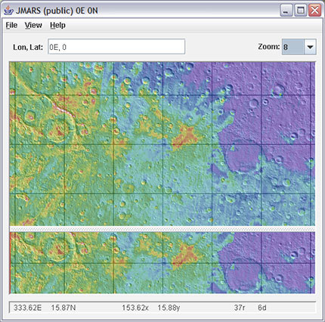
JMars
Java Mission-planning and Analysis for Remote Sensing
Java-based geospatial information system developed by the Mars Space Flight Facility at Arizona State University
http://jmars.asu.edu/wiki/index.php/Main_Page
Used for mission planning by several NASA missions, including Mars Odyssey, Mars Global Surveyor, Mars Reconnaissance Orbiter
Used by researchers, enthusiasts and students world wide to analyze Mars data.
java.sun.com/javaone/images/JMARSscreenshot.jpg

Slide 4
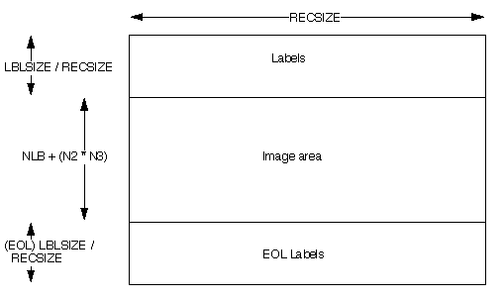
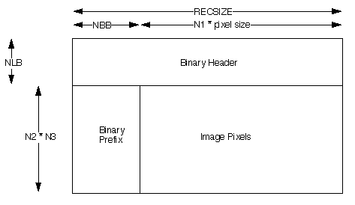
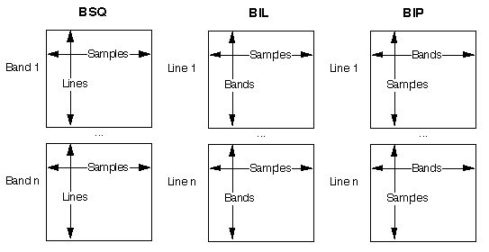
VICAR File Format
VICAR is one of the scientific data formats supported by JMARS
It can store hyperspectral data (100's of bands).
Can store more than just byte data (half, full, double)
The data can be stored in different organizations (BSQ,BIL,BIP)
http://www-mipl.jpl.nasa.gov/external/VICAR_file_fmt.pdf

Slide 5

ImageIO plugin
ImageIO plug-ins provide a uniform way of transcoding image data across various formats, hiding format differences.
Converted a basic Java VICAR reader/writer into the ImageIO format
http://blogs.zdnet.com/security/images/java_logo.gif
Added functionality to the basic plug-in

Slide 6
Challenges
Understanding how the Java ImageIO plug-ins work
Understanding the VICAR file format
Using BufferedImages, Rasters, I/O streams, ColorModels, SampleModels

Slide 7
Importance of My Project
VICAR plug-in incorporated into JMars
Open source software that can be used by anyone
Can read floating point and double type data from scientific instruments

Slide 8
Thank You!

